Slide 1

Note: The data and information in this document is reflective of a hypothetical situation and client. This document is to be used for KPMG Virtual Internship purposes only.
Sprocket Central Pty Ltd
Data analytics approach
[Ameen Magobon Abdulfatai ] -

Slide 2
Note: The data and information in this document is reflective of a hypothetical situation and client. This document is to be used for KPMG Virtual Internship purposes only.
Agenda
Introduction
Data Exploration
Model Development
Interpretation

Slide 3
Note: The data and information in this document is reflective of a hypothetical situation and client. This document is to be used for KPMG Virtual Internship purposes only.
Introduction
New Customer Analysis
Comprehensive plan for data analysis, customer identification, and marketing optimization.
Features Used for New customer Recommendation:
Age Distribution
Wealth Segement
State
Purchases in The last three years

Slide 4
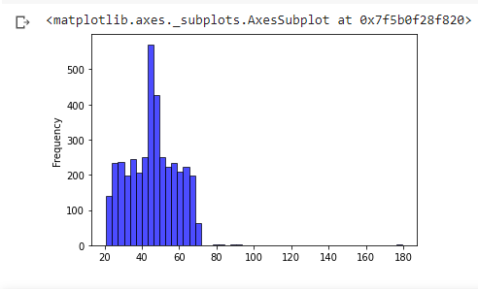
Note: The data and information in this document is reflective of a hypothetical situation and client. This document is to be used for KPMG Virtual Internship purposes only.
Data Exploration
Workflow
Import customer demo, address, and transaction datasets into data analysis tool.
Conduct initial EDA to analyze data distribution, identify missing values, and comprehend data structure.
Clean and pre-process data
Visualize the data
Identify potential relevant features for the analysis

Slide 5
Note: The data and information in this document is reflective of a hypothetical situation and client. This document is to be used for KPMG Virtual Internship purposes only.
Data Exploration
Age Distribution - Exploration Visualization Example
There are more customers between the ages of 40 and 60
Surprisingly, we have less than 100 customers over the age of 65
.There are more customers in the age group between 25 and 44 years old
Place any supporting images, graphs, data or extra text here.

Slide 6
Note: The data and information in this document is reflective of a hypothetical situation and client. This document is to be used for KPMG Virtual Internship purposes only.
Model Development
Workflow
Split the data into a training set and a testing set
Select and fit a suitable machine learning model to the training data
Evaluate the performance of the model on the testing data and make any necessary modifications to improve performance.
Refine the model by exploring different algorithms, feature selection methods, and parameter tuning techniques.

Slide 7
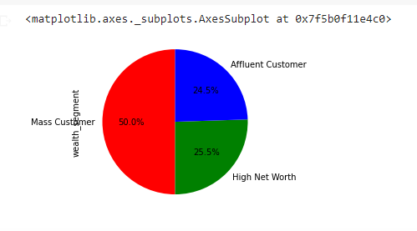
Note: The data and information in this document is reflective of a hypothetical situation and client. This document is to be used for KPMG Virtual Internship purposes only.
Model Development
Wealth Segement
High net worth customers only make up about 25% of the customers
.Affluent customers make up 24.5%
Mass Customers make up about 50% of the total customer
Place any supporting images, graphs, data or extra text here.

Slide 8
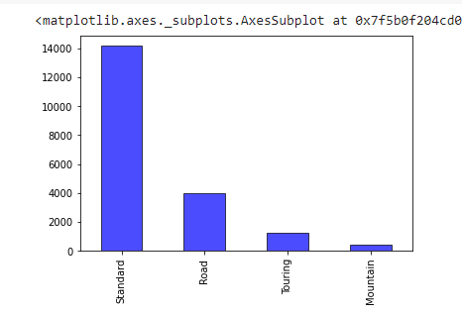
Note: The data and information in this document is reflective of a hypothetical situation and client. This document is to be used for KPMG Virtual Internship purposes only.
Model Development
Product Line
Mountain Bikes are then least sold with less than 1000 units.
Standard bikes are the most sold with sales of more than 14000 units
Road bikes sells close to 4000 units while Touring Bikes sells for around 1500 units

Slide 9
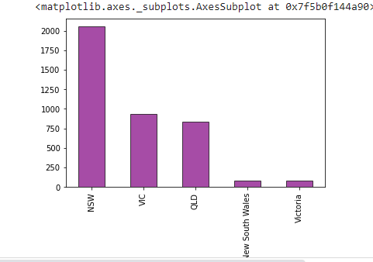
Note: The data and information in this document is reflective of a hypothetical situation and client. This document is to be used for KPMG Virtual Internship purposes only.
Model Development
State
Top Performing states in Australia
New South Wales has the most
Victoria has the least

Slide 10
Note: The data and information in this document is reflective of a hypothetical situation and client. This document is to be used for KPMG Virtual Internship purposes only.
Interpretation
Workflow
Predict new customer data using final model.
Interpret results, target top customers for marketing.
Prepare report summarizing findings, with visualizations and recommendations for targeted marketing.
Present report, discuss results and limitations.

Slide 11
Note: The data and information in this document is reflective of a hypothetical situation and client. This document is to be used for KPMG Virtual Internship purposes only.
Appendix

